Slide 1

Mini Project –Semester IV Internal Presentation Part - 1
Title: Job Portal Web Application
BY:
Prajyot Bhoir Dhanvi Mange Abhishek Shinde
Roll no : 119A3011 Roll no: 119A3013 Roll no: 119A3003
Under the guidance of
Ms. Seema Redekar
Department of Information Technology
SIES Graduate School of Technology, Nerul

Slide 2
Index
Introduction
Literature survey
Existing system
Proposed system
Problem definition
Hardware and software requirements
Process Design
Applications
Conclusion
References (as per IEEE format)

Slide 3
Introduction
The aim of this project is to develop an online job search Portal for the jobseeker.
The system is an online application that can be accessed throughout the organization and outside as well with proper login provided.
This system can be used as an Online Job Portal for job seekers. Job Seekers would be able to upload their information in the form of a CV. They would also be able to add reviews about different companies.
Visitors/Company representatives logging in may also access/search any information put up by Job aspirants.They can also view the reviews given by the users.

Slide 4
Literature Survey
Sr. no | Author | Title and Publication | Key Findings
1. | J. Dorn and T. Naz | “Integration of Job portals by Meta-search,” | Before the Internet, became widely uses as a method of seeking jobs, jobseekers spent a lots of time using various methods to look for job openings.
2. | M. Mansourvar and N. Y. Mohd, | “Web portal as a knowledge management system in the universities,” | The Internet plays an important role in the area of human resource planning and development. Most planning and development organizations are now using computer technology and the Internet for staff recruitment.

Slide 5
Existing System
The existing systems enables jobseekers to search through print media like poster advertisements, newspapers and visual media like television or company websites for employment opportunities.
This is a tedious task as it takes a lot of time and energy to search for the right job position, learn about the position and about the company. Job search for proper match of skill set and salary is challenging.
Job seekers can also find jobs through job fairs where they must first make it possible to attend the fairs which might be sometimes impossible with their schedules and if they visit the fairs they must hand over paper printed resumes.
The more the number of candidates the more the number of papers for the company which is a lot of manual effort. Again, jobseekers might get job offers through placement cells in respective colleges but getting hold of the right opportunity at the right time is always challenging.
On the other hand, the same goes for employers who are looking for candidates who are best fitted for their job positions. They must constantly advertise, go to a lot of job fairs which still doesn’t guarantee the best way to select from a large pool of candidates.

Slide 6
Proposed System
With the advancement of technology job seekers are relying greatly on Online Job Search Portals.
In the proposed system we are trying to develop an online job search web application that reduces challenges for job seekers to find a desired and suitable job according to their qualification. We aim at reducing the challenges by providing advanced search features that gives the candidate ample scope to select jobs that matches their skill set and requirements and gives them back the exact jobs that are available.
This in turn is less time taking as the candidate gets all details in one place and do not have to go to company website to learn about the positions. In the proposed system job seekers can upload their resumes in the required file format, see all the available jobs and search for desired jobs and then apply for those jobs.
On the other hand, this system enables employers to post their jobs and get a list of all applications which they can screen online and that reduces the huge amount of manual effort and time. Online recruitment or e-recruitment is turning out to be both the job seekers and the employers’ favorite activity as offer and demand are well met at one place and both must spend less time to get hold of the right roles or candidates.
The company can post jobs, see applications and check resumes in the proposed system.

Slide 7
Problem Definition
The system after careful analysis has been identified to be presented with the following modules :
Job Seeker :-
In this module Job Seeker will search for the available jobs and he/she can apply for the jobs by filling the necessary details and uploading the resume. He/she will be able to add/view reviews about a particular company.
Job provider :-
In this module Job Provider will firstly register himself /company and after login he can post the job. He also has an access to update or delete a job which he might had posted in the past . He can offer the job to job seeker according to the job profile and he can also see the response from the job seekers and send the mail.He can view the reviews posted by the user and make necessary changes in the company.

Slide 8
Software Requirements
Database : SQLite
IDE :VS Code
Language: Python
Browser : Chrome
Operating System: Windows 7 and above

Slide 9
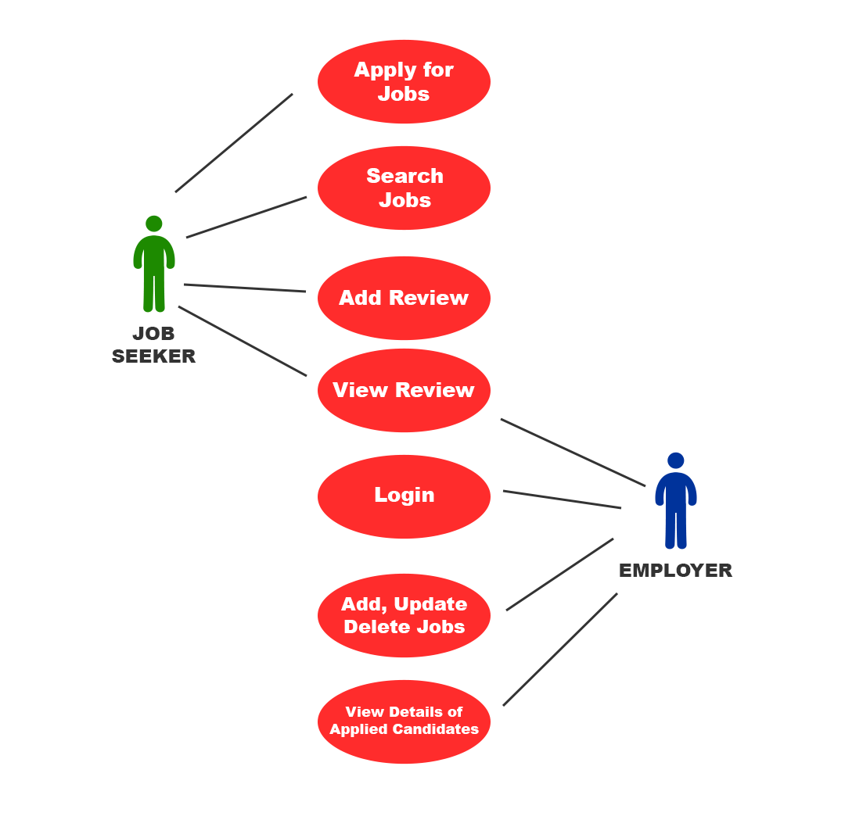
Use Case Diagram

Slide 10
Applications
Job search has become easier for all the aspiring candidates. It has also become easier for recruiters to post their requirements and search for right candidates matching their requirements.
Save time & work load for Staff and students.
Easy to access.
Only Eligible students get chance.
Improve accuracy in result.
It will have a user friendly interface .

Slide 11
Conclusion
It is difficult for both job seeker and job provider to find the perfect company and candidate respectively. The present system is very time consuming and there is a lot of manual work required. The proposed Job Portal enables the seeker to match its profile with the requiring post and apply for it. This helps both the sides to save lot of time. The seeker can also post a review of the company without revealing his identity. This review system enables not only the company to improve itself but also helps other users to analyze the company.
It also saves lot of paperwork as the resume uploaded is digital. The company can further reach the candidates either by mailing or sending messages.

Slide 12
References
https://www.tutorialspoint.com/index.htm
www.w3school.com
https://www.youtube.com/watch?v=3aVqWaLjqS4&list=PLosiE80TeTtoQCKZ03TU5fNfx2UY6U4p&index=9

